Slide 1
Smart Bus connection Topology and Adresses
Course 20 Minutes
Test 10 Minutes

Slide 2
What is Smart Bus?
What is Bus?

Slide 3
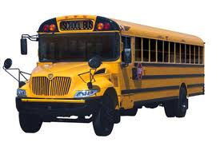
What is Smart Bus?
What is Bus?

Slide 4
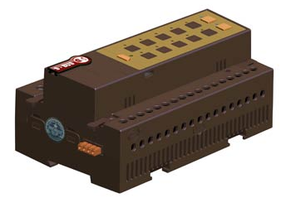
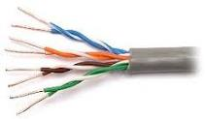
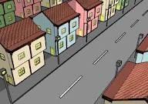
Where is smart bus line?
Smart bus = RS485

Slide 5
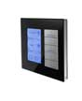
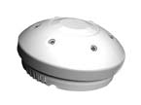

Slide 6
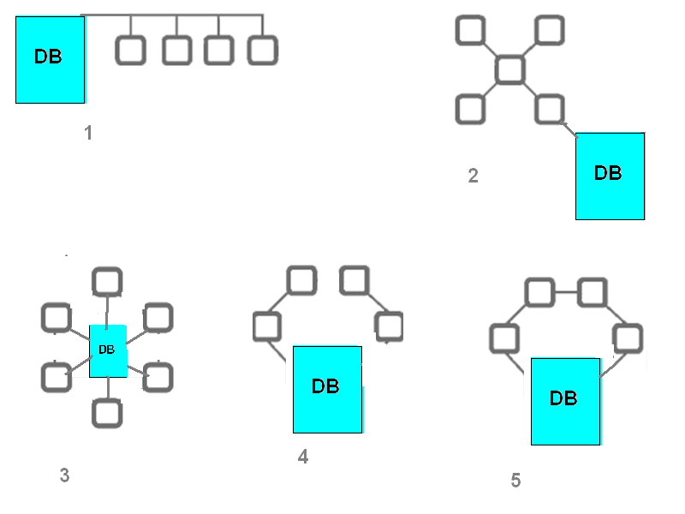
In What correct Topology We can connect our bus cable?

Slide 7
We can use any Topology to connect…

Slide 8
Easy to wire , install and program
AS Simple as Christmas Tree Wire Concept
10- 100 – 1000 – 0r even 56000 Bulbs on one Wire
Internet Have Millions of Nodes and PC’s Working at same Time

Slide 9
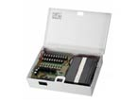
How many Power supply we need?
24V DC /2A output
24V DC 1.1 A output
Average consumption for each module 35mA

